Slide 1
Introduction to Computing for Data Analysis
Compression via PCA+SVD
Richard Vuduc, Ph.D.
Associate Professor
School of Computational Science and Engineering
Motivating examples
Notes:
Hi there! Are you ready to tackle a new topic?
I thought it would be fun to talk about data “compression,” by which I mean finding a smaller representation of some dataset.

Slide 2
Introduction to Computing for Data Analysis
Compression via PCA+SVD
Richard Vuduc, Ph.D.
Associate Professor
School of Computational Science and Engineering
Motivating examples
Notes:
In a way, even linear regression is a form of compression.
That’s because you effectively take many data points and replace them with just a few coefficients, which represent some hyperplane that “fits” the data.

Slide 3
Motivation for compression
Compression task: Find a smaller representation of the data to…
Notes:
But in this topic, I want you to think about compression with two different analysis goals in mind.

Slide 4
Motivation for compression
Compression task: Find a smaller representation of the data to…
make the dataset smaller to save space or time;
Notes:
The first goal is to make the dataset smaller.

Slide 5
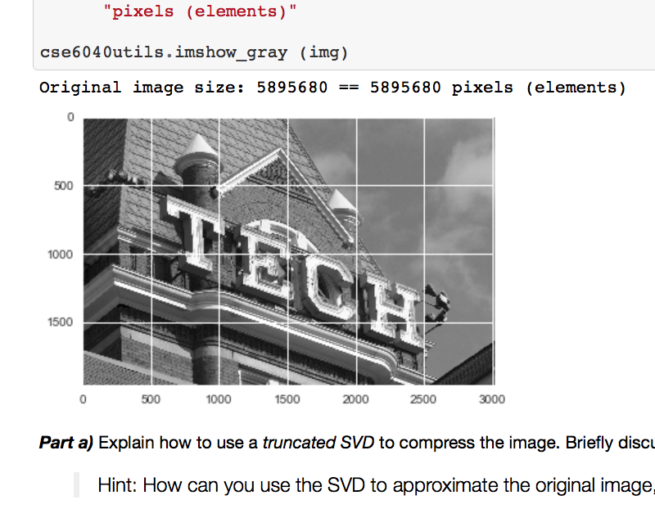
Compression example
Notes:
For instance, here is an example from one of the Jupyter notebooks that accompany this lesson.

Slide 6
Compression example
Notes:
It’s an image. @TODO: Highlight image
And viewed as a data object, the data points might be the pixels, or the rows, or the columns, or even subblocks.

Slide 7
Compression example
Notes:
Now, to store every pixel, for this image you’d need space for about 5.9 million elements.
@TODO: Highlight size
However, there is a lot of structure here that would allow you to find a smaller representation.

Slide 8

Compression example
Notes:
In the notebook, you’ll apply one such technique, called the truncated singular value decomposition, or SVD.
@TODO: Highlight ”truncated SVD”
Here is the result:

Slide 9
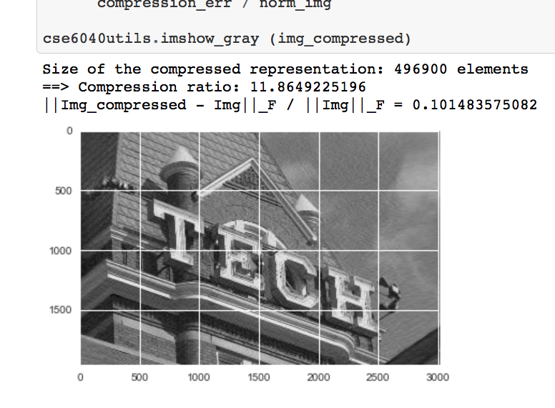
Compression example
Notes:
It’s only 10% the size of the original! @TODO: Highlight size!

Slide 10
Compression example
Notes:
And even though it is *not* identical to the original, it’s visually hard to distinguish from the original.
So, depending on the application, might be an equally usable representation.

Slide 11
Motivation for compression
Compression task: Find a smaller representation of the data to…
make the dataset smaller to save space or time;
Notes:
So that’s one motivating application for compression.
Here is another one:

Slide 12
Motivation for compression
Compression task: Find a smaller representation of the data to…
make the dataset smaller to save space or time;
reveal hidden structure(s).
Notes:
Finding or revealing *hidden* structure.
So what does that mean?

Slide 13
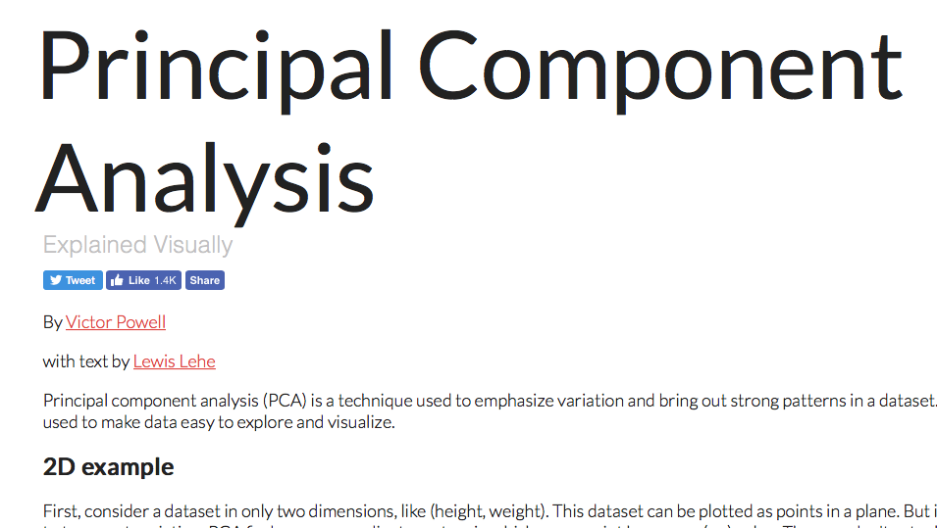
Hidden structure example
setosa.io/ev
Notes:
Here’s an entertaining example that comes from the incredibly cool blog, “Explained Visually,” by Victor Powell and friends.
@TODO: Highlight “Explained Visually” name and URL

Slide 14
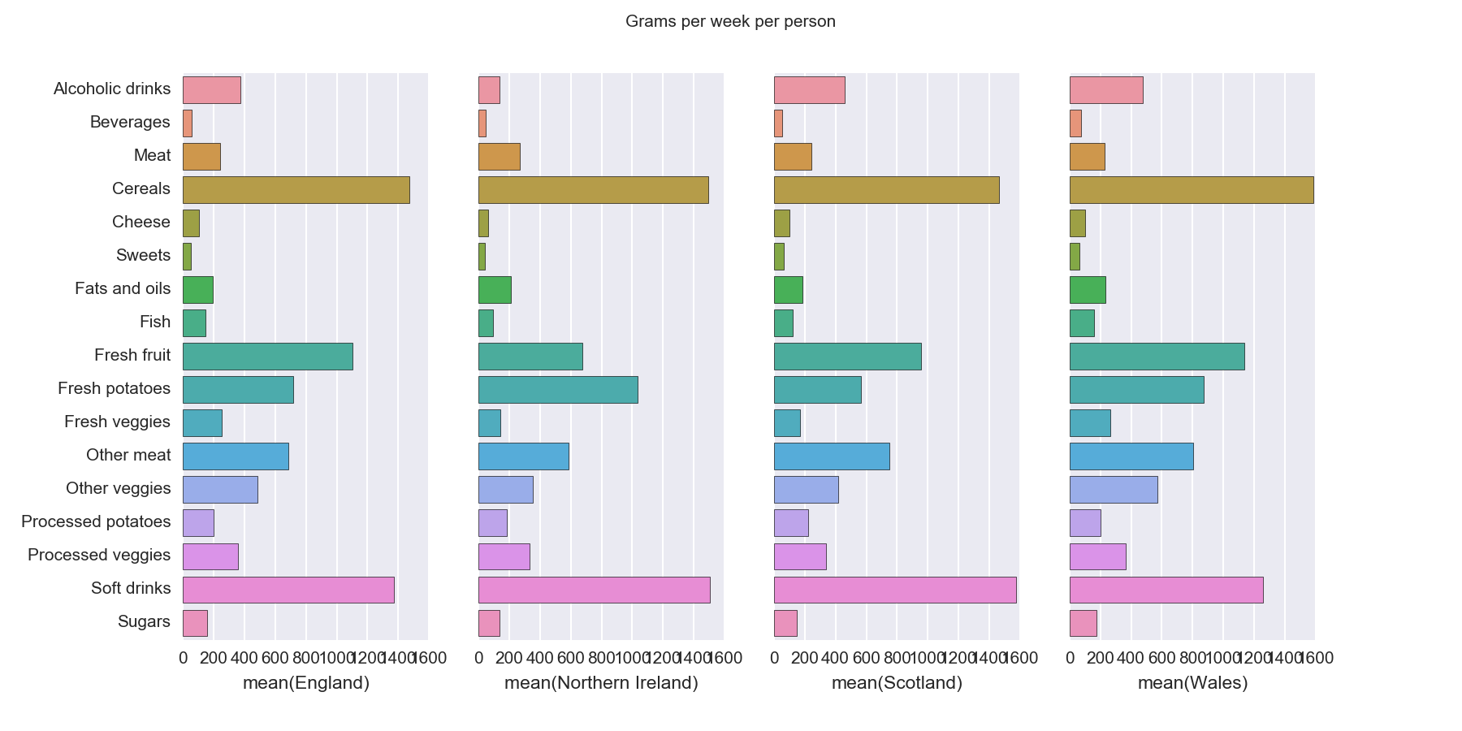
Hidden structure example
Notes:
It’s nutrition data collected across four countries within the United Kingdom: England, Northern Ireland, Scotland, and Wales. @TODO: Highlight country names

Slide 15
Hidden structure example
Notes:
For each one, researchers measured the average per capita consumption, in grams, of various types of food. @TODO: Highlight “Grams” and list of food products.

Slide 16
Hidden structure example
Notes:
Just for fun, you might pause for a moment and see if you can characterize what makes them similar or different.
By visual inspection alone, I hope you’d agree it’s hard to know how to compare the apparent eating habits countries.

Slide 17
Hidden structure example
Notes:
One issue is that there are a lot of dimensions for comparison – in this case, 17. @TODO highlight food groups

Slide 18
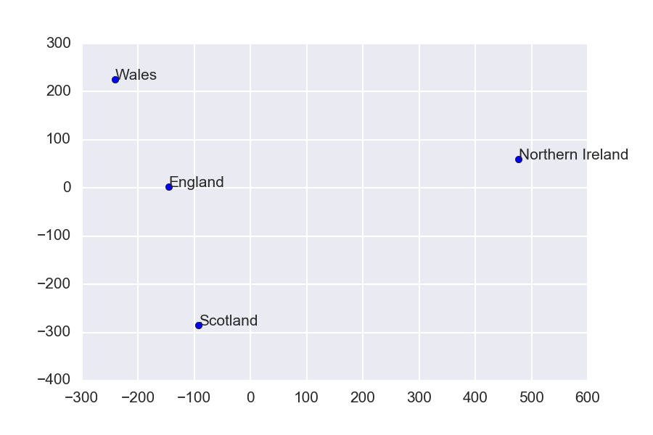
Notes:
By judiciously using the same tool of the “singular value decomposition,” you could instead come up with this picture!

Slide 19
Notes:
It reduces the number of dimensions from 17 to just 2. @TODO: Highlight axes

Slide 20
Notes:
And from this projected data, it appears that the eating habits in Northern Ireland may be distinct in some interesting way from those of England, Scotland, and Wales.
@TODO: Highlight Northern Ireland

Slide 21
Notes:
In summary, I’d like to suggest that compressing data is an interesting task for two reasons.
One is because it can reduce the volume of a dataset.
But the other is that it can reveal structure in that data.

Slide 22
Notes:
In the next few lessons, you’ll explore a specific example of a compression technique.
Then, in the notebooks that accompany this topic, you’ll code up that technique and try it out on the examples you saw in this lesson.
I hope it will be fun. So, see you next time!

